Slide 1
Collissions between wildlife and airplanes between 2001 and 2015
File created on: 1/31/2023 12:58:41 PM

Slide 2
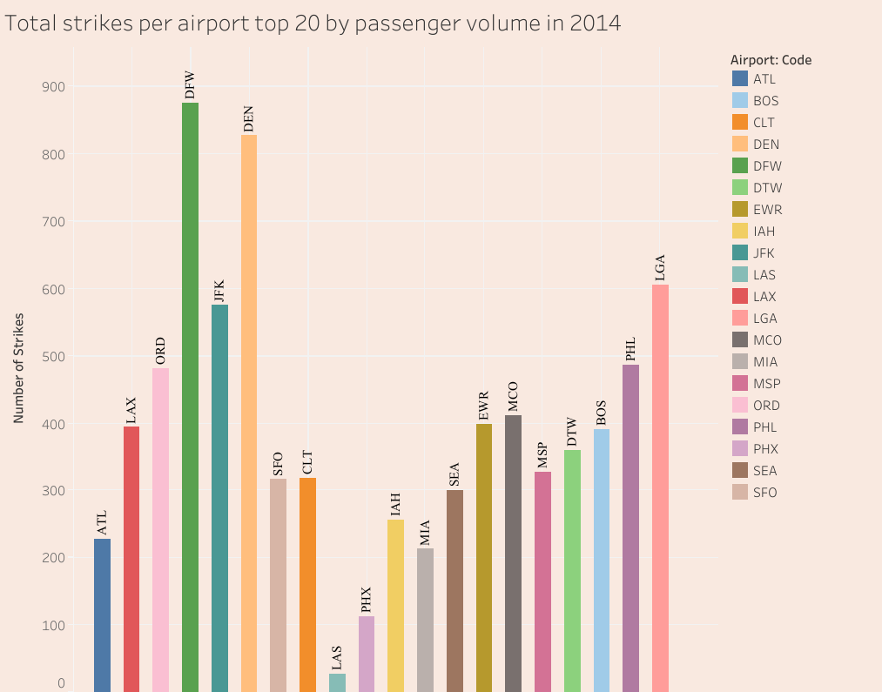

Slide 3
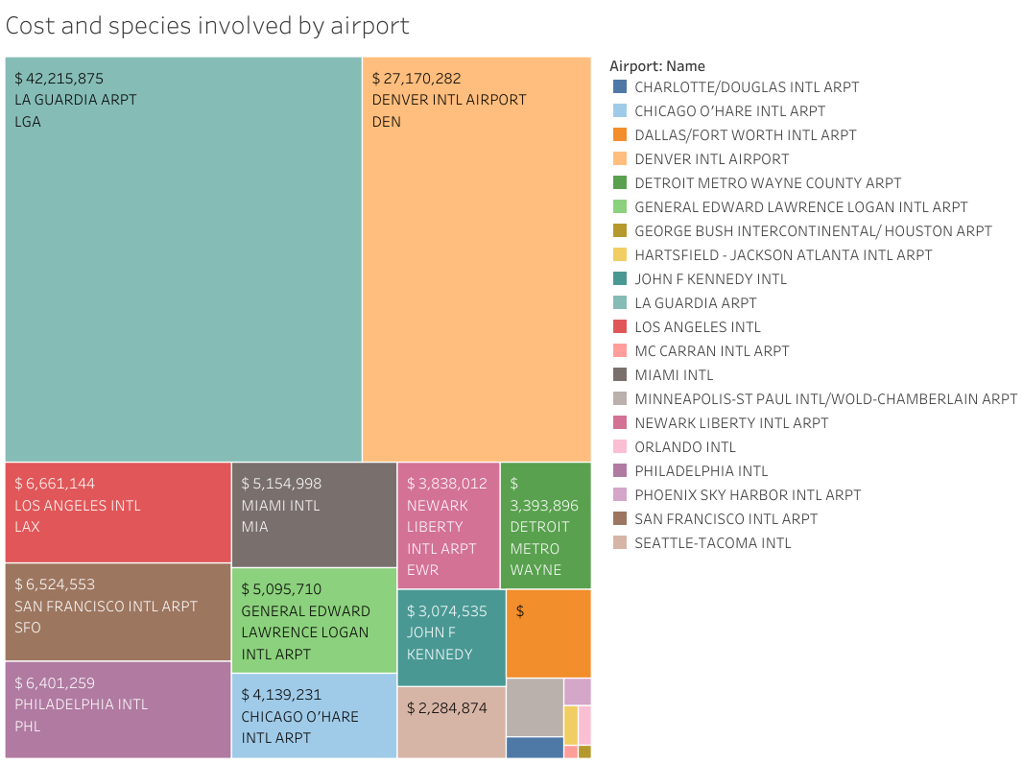

Slide 4
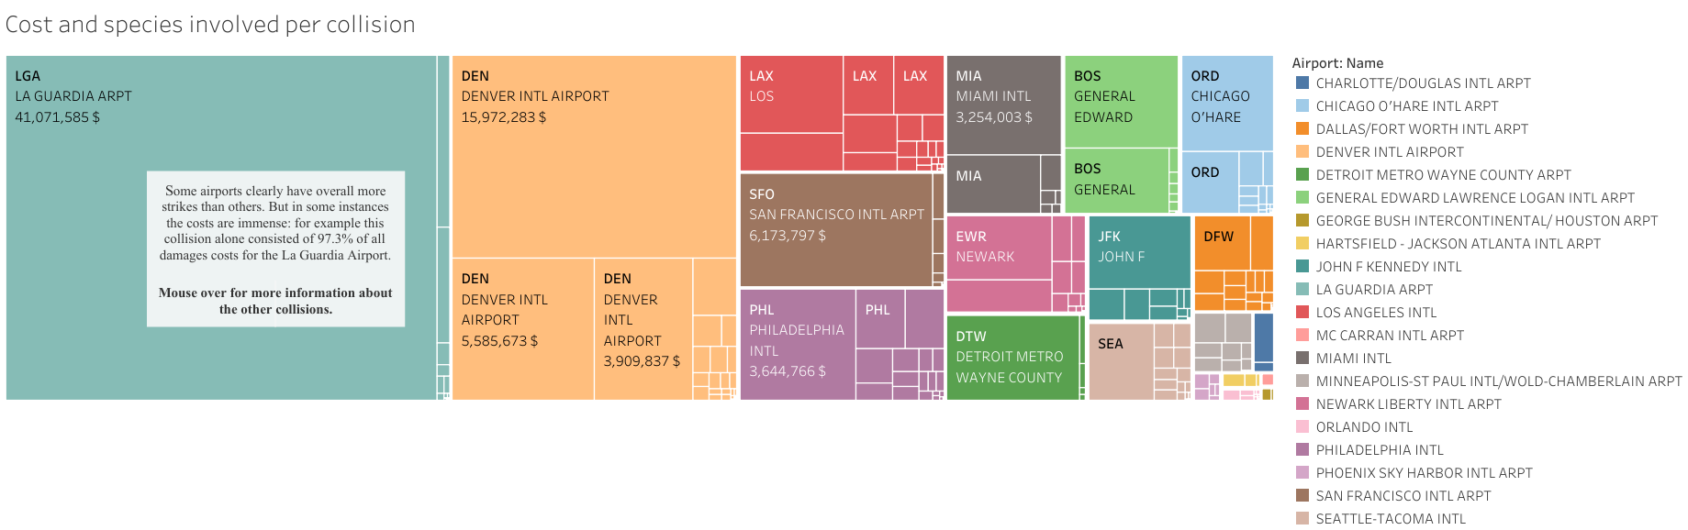

Slide 5
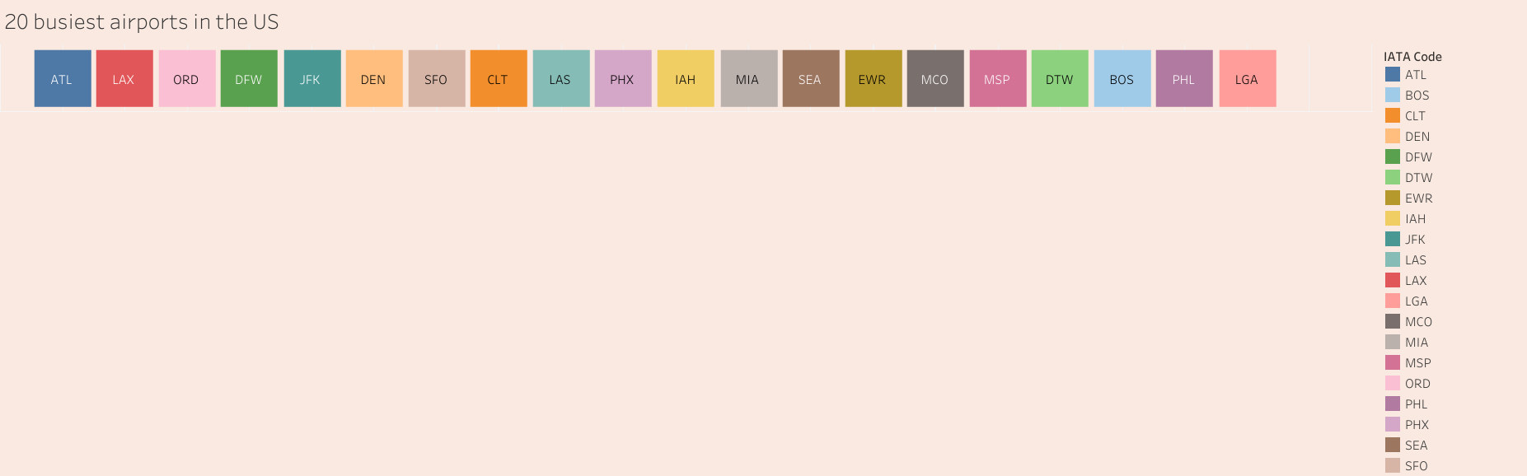

Slide 6
